Slide 1



Waste Classification Using Convolutional Neural Networks (CNN)
By Grisha Lala

Slide 2

Learning Objectives
Understand the importance of waste classification for environmental sustainability.
Learn how CNN models (ResNet, AlexNet, and VGG) can be applied for image classification.
Analyze the performance of different deep learning architectures in classifying waste.
Develop practical skills in data preprocessing, model training, and evaluation.
GOAL
Source :
www.freepik.com/

Slide 3
Tools and Technology used
Programming Language: Python
Frameworks & Libraries: TensorFlow, Keras, OpenCV, NumPy, Pandas, Matplotlib
Models: ResNet, AlexNet, VGG
Development Environment: Google Colab, Jupyter Notebook
Dataset: Waste Classification Dataset (preprocessed and augmented)

Slide 4
Methodology
Data Collection & Preprocessing – Collected images of waste, resized, normalized, and augmented the dataset.
Model Selection – Implemented ResNet, AlexNet, and VGG for classification.
Training & Evaluation – Trained models using labeled waste images and evaluated accuracy using test data.
Comparison of Results – Compared model accuracy, precision, recall, and F1-score.
Deployment Considerations – Discussed potential applications for real-world waste classification systems.

Slide 5
Problem Statement:
Waste misclassification leads to inefficient recycling and environmental pollution. Manual sorting is time-consuming and error-prone. This project aims to develop an AI-based solution for accurate waste classification using CNN models.

Slide 6
Solution:
Our deep learning-based approach automates waste classification by leveraging CNN models trained on labeled images. This system improves accuracy, reduces human effort, and enhances waste management efficiency.

Slide 7
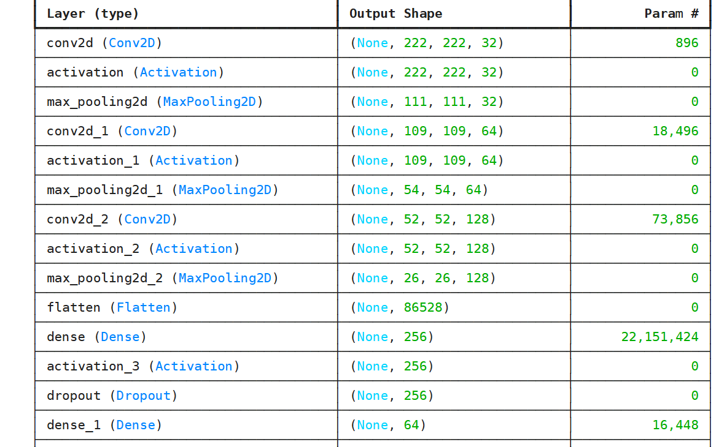
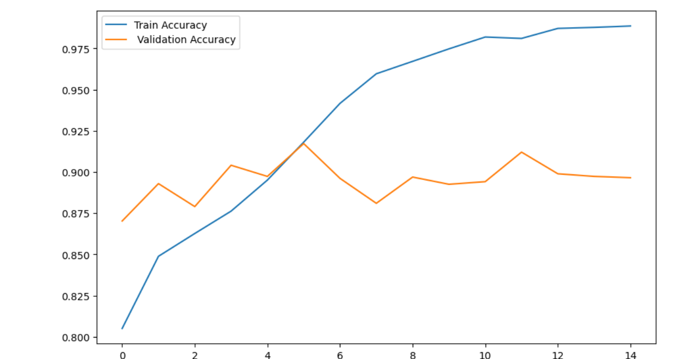
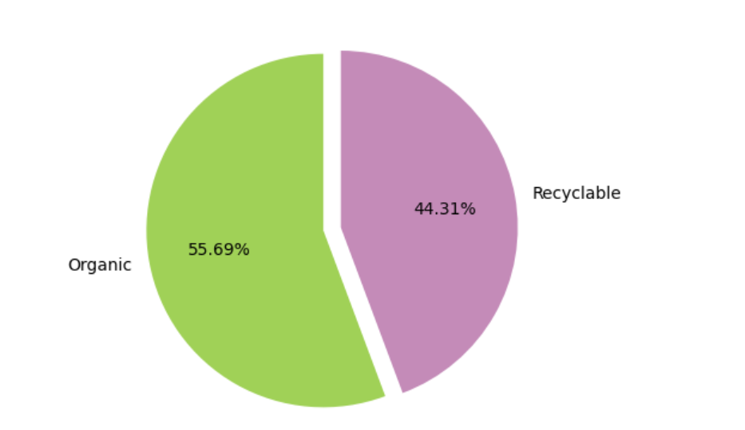
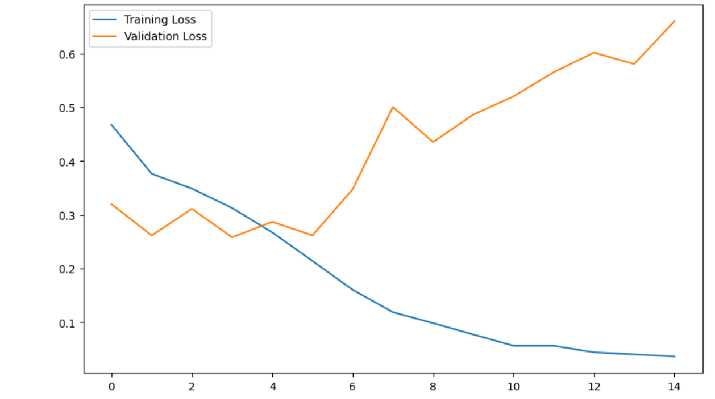
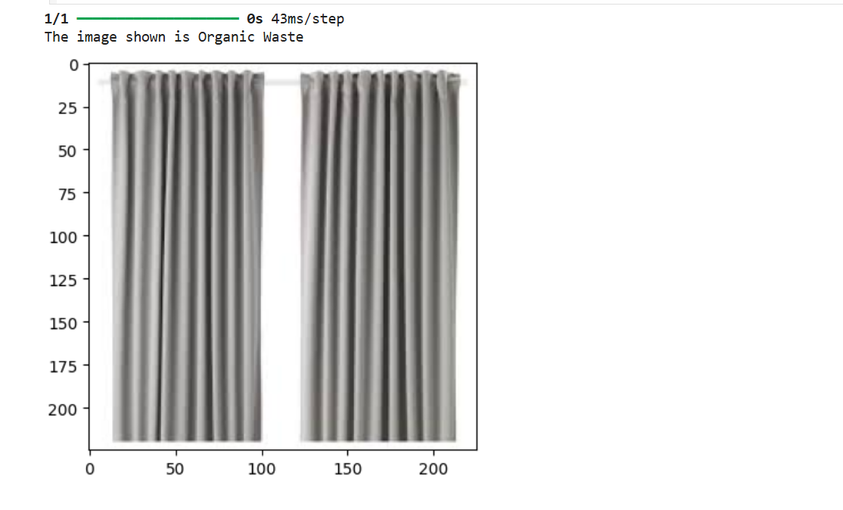
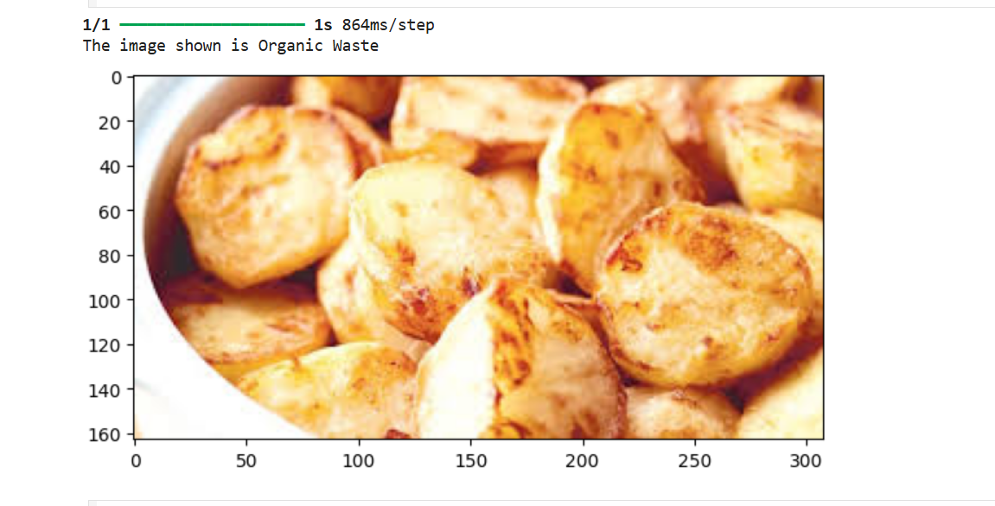
Screenshot of Output:

Slide 8
Conclusion:
CNN-based waste classification significantly improves accuracy in sorting waste materials.
Among the tested models, [mention best-performing model] provided the highest accuracy.
The system can be integrated with IoT and edge devices for real-time waste sorting applications.
Future work includes expanding the dataset and optimizing the models for real-world deployment.

